Slide 1


Olena Kirieva
14.01.2025

Slide 2

Outline
Executive Summary
Introduction
Methodology
Results
Conclusion
Appendix

Slide 3
Executive Summary
Summary of methodologies
Data Collection through API
Data Collection with Web Scraping
Data Wrangling
Exploratory Data Analysis with SQL
Exploratory Data Analysis with Data Visualization
Interactive Visual Analytics with Folium
Machine Learning Prediction
Summary of all results
Exploratory Data Analysis result
Interactive analytics in screenshots
Predictive Analytics result

Slide 4
Introduction
Project background and context
Space X advertises Falcon 9 rocket launches on its website with a cost of 62 million dollars; other providers cost upward of 165 million dollars each, much of the savings is because Space X can reuse the first stage. Therefore, if we can determine if the first stage will land, we can determine the cost of a launch. This information can be used if an alternate company wants to bid against space X for a rocket launch. This goal of the project is to create a machine learning pipeline to predict if the first stage will land successfully.
Problems you want to find answers
What factors determine if the rocket will land successfully?
The interaction amongst various features that determine the success rate of a successful landing.
What operating conditions needs to be in place to ensure a successful landing program.

Slide 5

Section 1

Slide 6
Methodology
Executive Summary
Data collection methodology:
Data was collected using SpaceX API and web scraping from Wikipedia.
Perform data wrangling
One-hot encoding was applied to categorical features
Perform exploratory data analysis (EDA) using visualization and SQL
Perform interactive visual analytics using Folium and Plotly Dash
Perform predictive analysis using classification models
How to build, tune, evaluate classification models

Slide 7
Data Collection
The data was collected using various methods
Data collection was done using get request to the SpaceX API.
Next, we decoded the response content as a Json using .json() function call and turn it into a pandas dataframe using .json_normalize().
We then cleaned the data, checked for missing values and fill in missing values where necessary.
In addition, we performed web scraping from Wikipedia for Falcon 9 launch records with BeautifulSoup.
The objective was to extract the launch records as HTML table, parse the table and convert it to a pandas dataframe for future analysis.

Slide 8

Data Collection – SpaceX API
We used the get request to the SpaceX API to collect data, clean the requested data and did some basic data wrangling and formatting.
The link to the notebook is github

Slide 9

Data Collection - Scraping
We applied web scrapping to webscrap Falcon 9 launch records with BeautifulSoup
We parsed the table and converted it into a pandas dataframe github

Slide 10

Data Wrangling
We performed exploratory data analysis and determined the training labels.
We calculated the number of launches at each site, and the number and occurrence of each orbits
We created landing outcome label from outcome column and exported the results to csv.
The link to the notebook is github

Slide 11
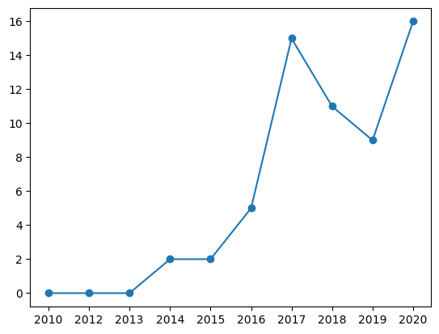
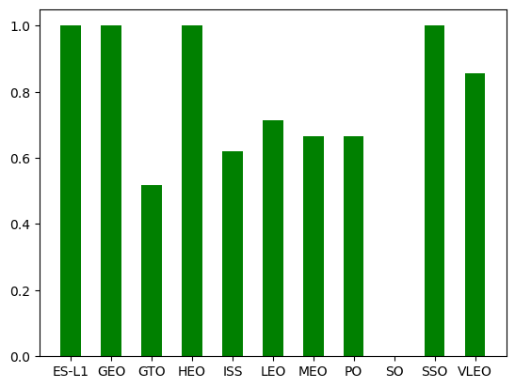
EDA with Data Visualization
Plot the launch success yearly trend
The link to the notebook is github

Slide 12
EDA with SQL
We loaded the SpaceX dataset into a PostgreSQL database without leaving the jupyter notebook.
We applied EDA with SQL to get insight from the data. We wrote queries to find out for instance:
The names of unique launch sites in the space mission.
The total payload mass carried by boosters launched by NASA (CRS)
The average payload mass carried by booster version F9 v1.1
The total number of successful and failure mission outcomes
The failed landing outcomes in drone ship, their booster version and launch site names.
The link to the notebook is github

Slide 13
Build an Interactive Map with Folium
We marked all launch sites, and added map objects such as markers, circles, lines to mark the success or failure of launches for each site on the folium map.
We assigned the feature launch outcomes (failure or success) to class 0 and 1.i.e., 0 for failure, and 1 for success.
Using the color-labeled marker clusters, we identified which launch sites have relatively high success rate.
We calculated the distances between a launch site to its proximities. We answered some question for instance:
Are launch sites near railways, highways and coastlines.
Do launch sites keep certain distance away from cities.

Slide 14
Build a Dashboard with Plotly Dash
SWe built an interactive dashboard with Plotly dash
We plotted pie charts showing the total launches by a certain sites
We plotted scatter graph showing the relationship with Outcome and Payload Mass (Kg) for the different booster version.
The link to the notebook is github

Slide 15
Predictive Analysis (Classification)
We loaded the data using numpy and pandas, transformed the data, split our data into training and testing.
We built different machine learning models and tune different hyperparameters using GridSearchCV.
We used accuracy as the metric for our model, improved the model using feature engineering and algorithm tuning.
We found the best performing classification model.
The link to the notebook is github

Slide 16
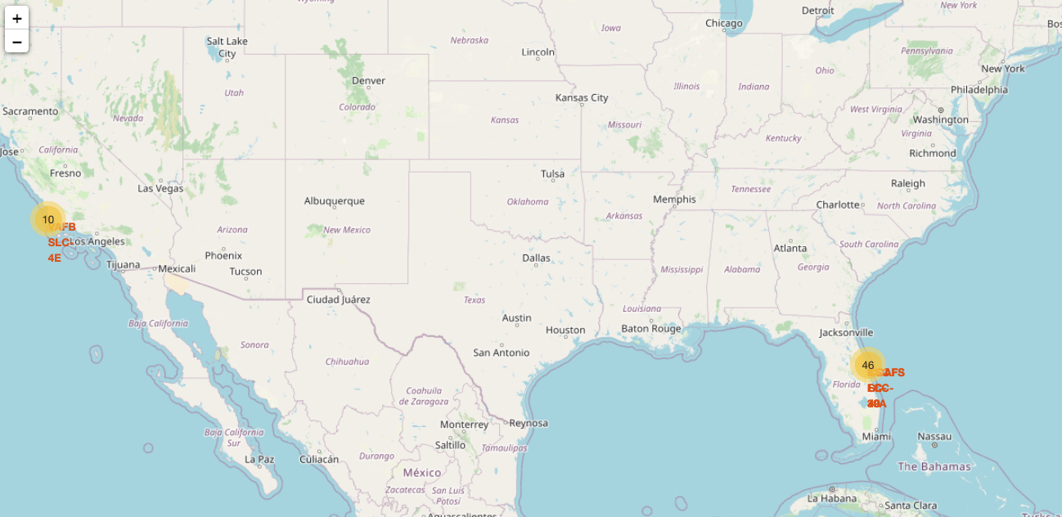
Results
Using interactive analytics was possible to identify that launch sites use to be in safety places, near sea, for example and have a good logistic infrastructure around.
Most launches happens at east cost launch sites.

Slide 17

Section 2

Slide 18

Flight Number vs. Launch Site
From the plot, we found that the larger the flight amount at a launch site, the greater the success rate at a launch site.

Slide 19
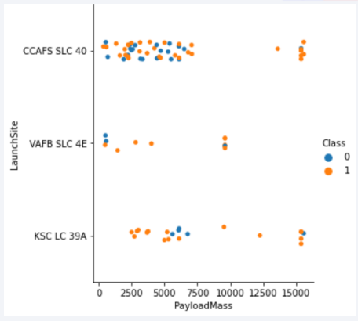
Payload vs. Launch Site
The greater the payload mass for launch site CCAFS SLC 40 the higher the success rate for the rocket.

Slide 20

Success Rate vs. Orbit Type
The orbits ES-L1, GEO, HEO, and SSO have an average success rate of 100%; excluding SO landing sites with a 0% of success rate, generally speaking, all landing sites have an average success greater than 50%.

Slide 21
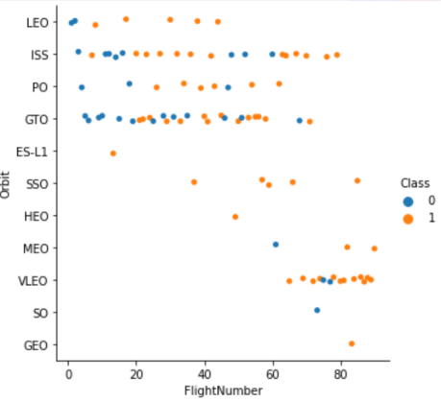
Flight Number vs. Orbit Type
• The LEO orbit the Success appears related to the number of flights.
• There seems to be no relationship between flight number when in GTO orbit.

Slide 22
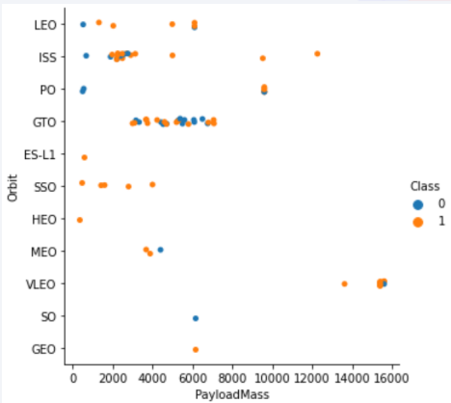
Payload vs. Orbit Type
• With heavy payloads the successful landing or positive landing rate are more for Polar, LEO, and ISS.
• For GTO we cannot distinguish this well as both positive landing rate and negative landing (unsuccessful mission) are both there here.

Slide 23
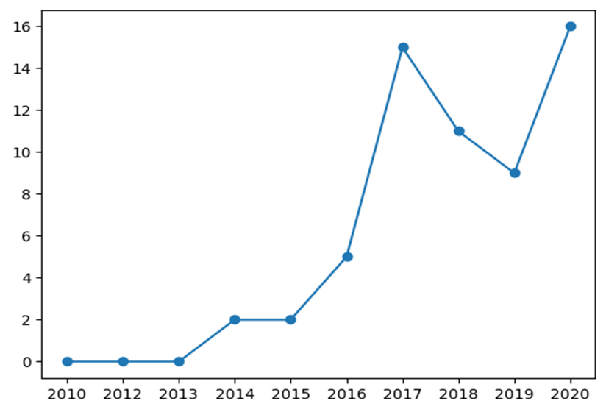
Launch Success Yearly Trend
• The success rate since 2013 kept increasing till 2020.

Slide 24

All Launch Site Names
The names of the unique launch sites are CCAFS LC-40, CCAFS SLC-40, KSC LC-39A, VAFB SLC-4E.

Slide 25
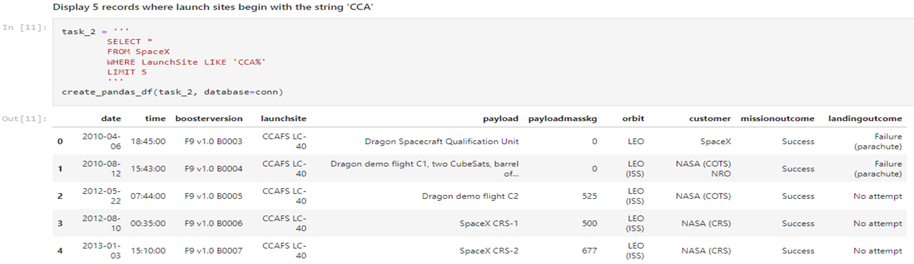
Launch Site Names Begin with 'CCA'
• The image shows 5 records where launch sites begin with ‘CCA’.

Slide 26
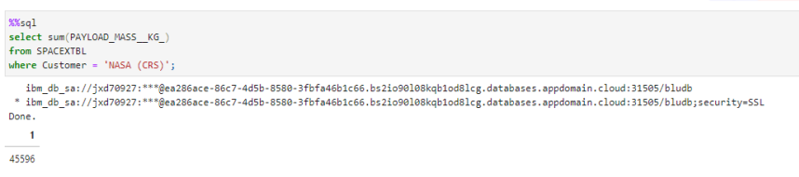
Total Payload Mass
We calculated the total payload carried by boosters from NASA as 45596 using the query below

Slide 27
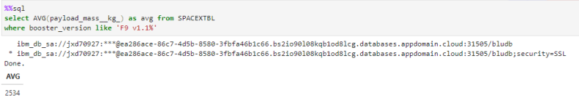
Average Payload Mass by F9 v1.1
We calculated the average payload mass carried by booster version F9 v1.1

Slide 28
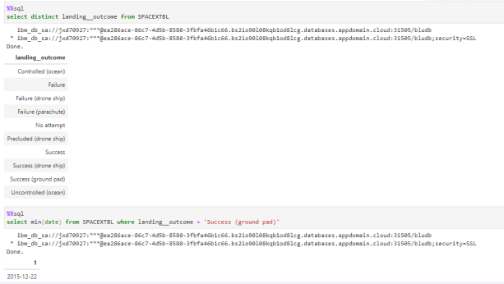
First Successful Ground Landing Date
We used DISTINCT to find the right value representing successful ground landing and then used MIN-function found the dates of the first successful landing outcome on ground pad

Slide 29
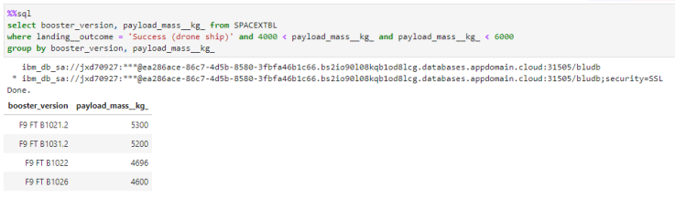
Successful Drone Ship Landing with Payload between 4000 and 6000
We used the WHERE clause to filter for boosters which have successfully landed on drone ship and applied AND condition to determine successful landing with payload mass greater than 4000 but less than 6000

Slide 30
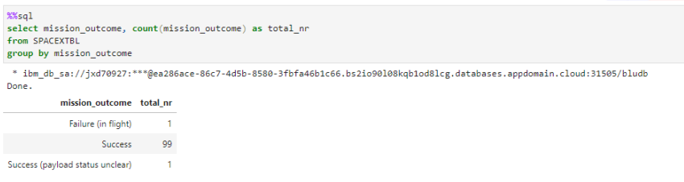
Total Number of Successful and Failure Mission Outcomes
We used wildcard like '%' to filter for WHER Mission Outcome was a success or a failure.

Slide 31
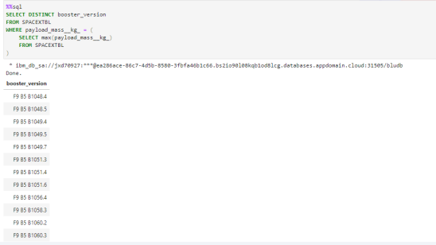
Boosters Carried Maximum Payload
We determined the booster that have carried the maximum payload using a subquery in the WHERE clause and the MAX() function.

Slide 32
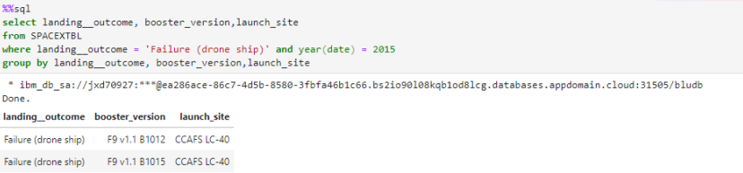
2015 Launch Records
• We used a combinations of the WHERE clause, LIKE, AND, and BETWEEN conditions to filter for failed landing outcomes in drone ship, their booster versions, and launch site names for year 2015

Slide 33
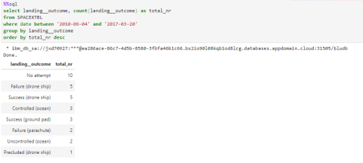
Rank Landing Outcomes Between 2010-06-04 and 2017-03-20
We used GROUP BY and ORDER BY to rank the count of landing outcomes (such as Failure (drone ship) or Success (ground pad)) between 2016-06-04 to 2010-03-20 in a descending order.

Slide 34

Section 3

Slide 35

Launch sites in Folium Map
It’s possible to notice two cluster launch sites in Florida and California.

Slide 36
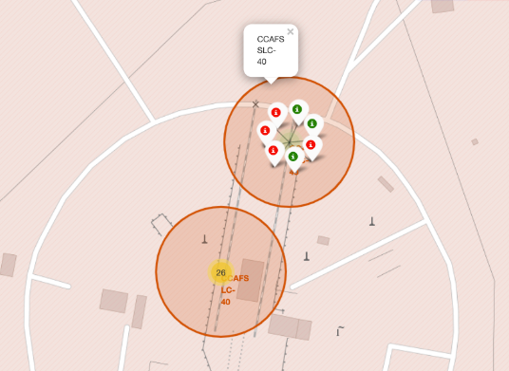
Outcome feature per launch site with Folium Map
• Folium allows us to visually analyze the outcome feature per launch site.
• For instance, for the launch site KSC LC 40 in Florida, there are 10 successful landings and 3 failed landings.

Slide 37
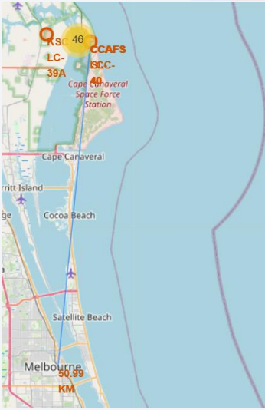
Distance between CCAFS SLC-40 launch site and its proximities
• The selected area for the distance analysis between the CCAFS SLC-40 launch site was Melbourne city.
• The distance between CCAFS SLC-40 and Melbourne city is 50.99 km.

Slide 38

Section 4

Slide 39
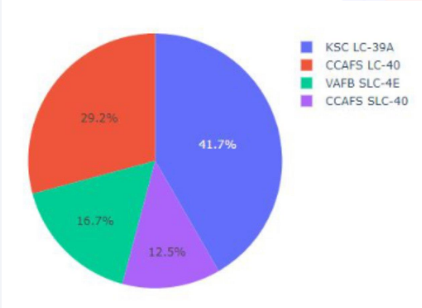
Total Success Launches by site
Through the pie chart, it’s possible to determine that the highest launch success rate is KSC LC-39 A with 41.7%, followed by CCAFS LC-40 with 29.2% and at the bottom the VAFB SLC4E, and CCAFS SLC-40 with 16.7% and 12.5%, respectively.

Slide 40
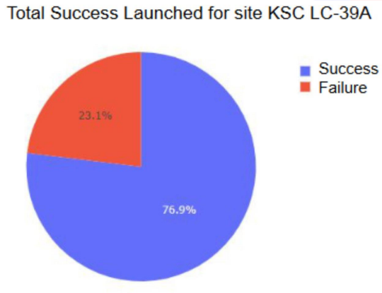
KSC LC-39A total Success Launches
Through the pie chart is possible to determine that KSC LC-39A has a 76.9% success rate.

Slide 41
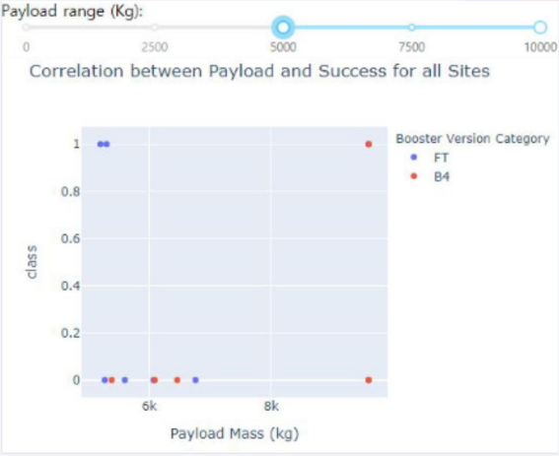
Correlation between payload and success for all sites
The plot shows the correlation between payload and success for all sites with a [5000,10000] range.
• With heavier payload mass it appears to end in an unsuccessful landing.

Slide 42

Section 5

Slide 43
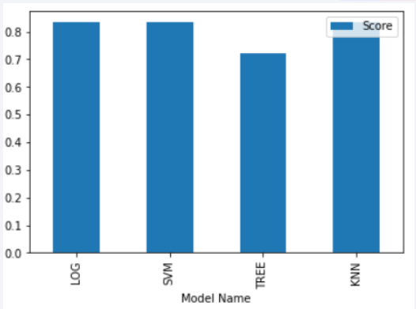
Classification Accuracy
The best performance models classifier were the logistic regression, SVM, and KNN, each with a score more of 80%.

Slide 44

Confusion Matrix
Support vector machine with the best parameters gives an excellent result

Slide 45
Conclusions
We can conclude that:
The larger the flight amount at a launch site, the greater the success rate at a launch site.
Launch success rate started to increase in 2013 till 2020.
Orbits ES-L1, GEO, HEO, SSO, VLEO had the most success rate.
KSC LC-39A had the most successful launches of any sites.
The Support vector machine is the best machine learning algorithm for this task.

Slide 46
Appendix
• The repository for this project is available here

Slide 47


